Slide 1

Early detection of Heart Attack
TEAM MEMBERS:
PRIYANSH SAHU (20BCS163)
RAGHAV PATIDAR(20BCS168)
KUSHAL GADDAMWAR(20BCS121)
NEERAJ KUMAR (20BCS144)
SWASTIK BHARTI(20BSM058)
MEHUL DEHURY (20BDS052)
KATTA NITISH (20BEC052)

Slide 2
AGENDA
Project Justification and Novelty
Project design
Data Overview
Budget
Summary and Future

Slide 3

Project Justification and Novelty
Heart diseases and problem still remains one of the largest cause of deaths among adults and senior citizen. The uncertainty of a heart attack, stroke, or collapse is the biggest fear of a heart patient. Not getting primary medical support and assistance on time causes a lot of these death or permanent irreparable damages.
According to the WHO, 17.90 million people died from cardiovascular disease (CVD) in 2016, accounting for 30% of all deaths globally and death counts are still increasing per year. According to the European Society of Cardiology (ESC), there are 26.5 million people in Europe who suffer from heart disease, with 3.8 million new cases being discovered each year.
Chronic heart diseases are one of the most dangerous and life-threatening disease worldwide. The fundamental cause of heart failure is narrowing and blockage of coronary arteries, where the heart fails to supply enough blood to other organs. The coronary arteries must be accessible to supply blood to the heart.

Slide 4
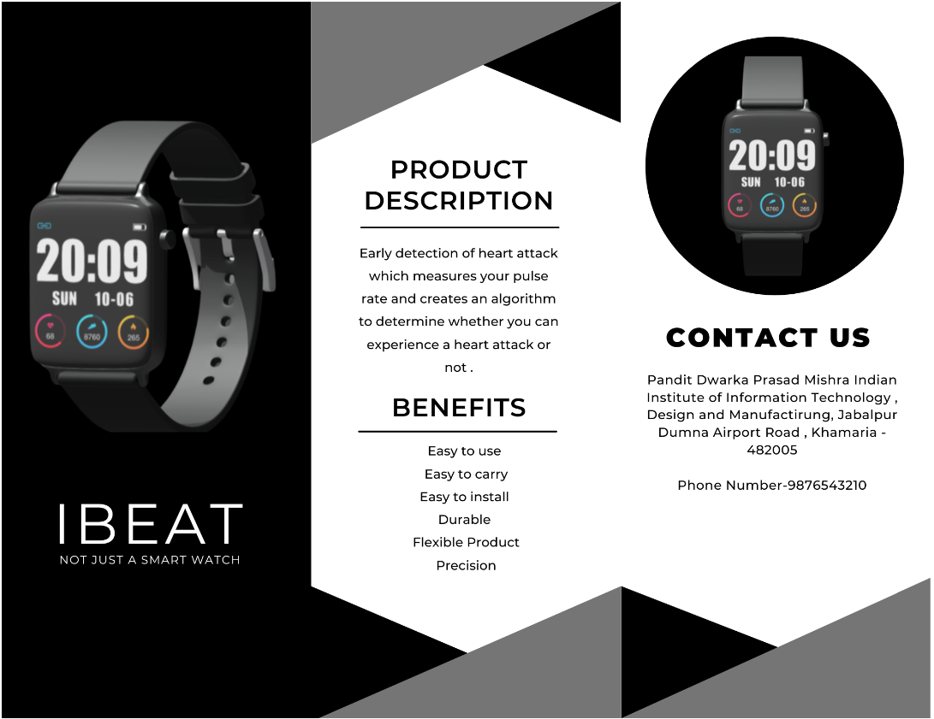
Project design
Our project tries to solve the uncertainty problem threw the help of AI and ML. A wearable portable device connected to your phone that can track your heart condition in real time and provide the data to your mobile and a database. This data will be continuously fed to an ML algorithm to detect any anomaly in your heart’s condition and detect if the person is having a heart attack.
WATCH + APP + LANDING PAGE

Slide 5
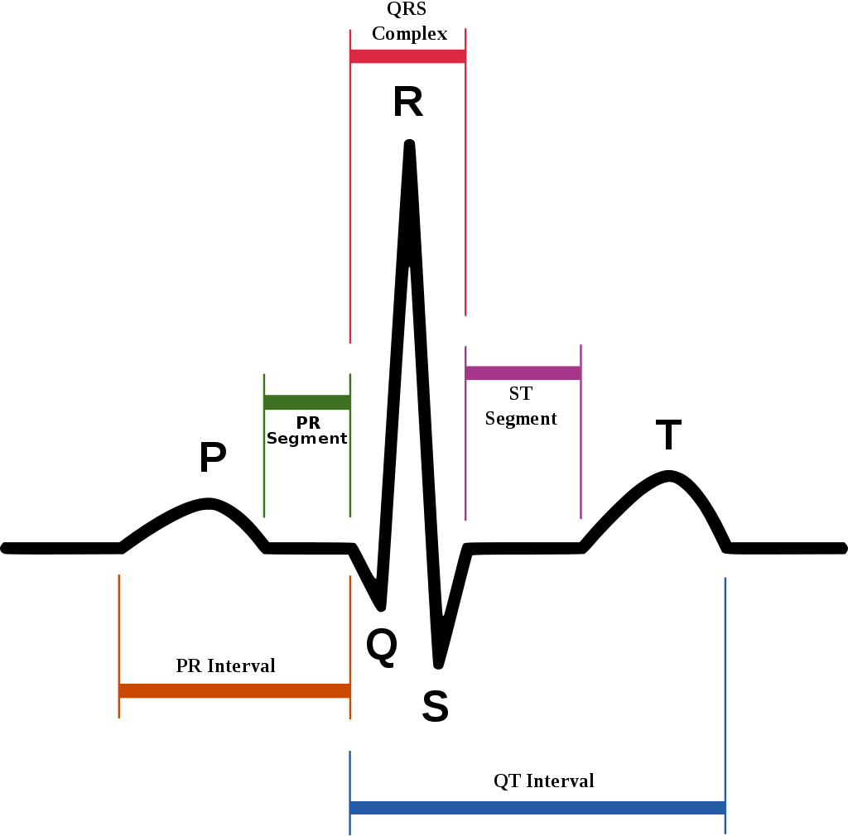
Data Overview
age: Age of the person (years)
sex: Sex of the person (M or F)
cp: Chest pain type
trtbps: Resting blood pressure (mm Hg)
chol: Cholesterol level (mg/dL)
fbs: Fasting blood sugar (categorical, if > 120 mg/dL)
restecg: Resting EKG results
thalachh: Maximum heart rate achieved (bpm)
exng: Exercise Induced Angina
oldpeak: ST depression ^{4, 5}
slp: Slope of ST segment ^{4, 5}
caa: Number of major vessels
thall: Thalassemia (blood disorder)
output: Target variable

Slide 6
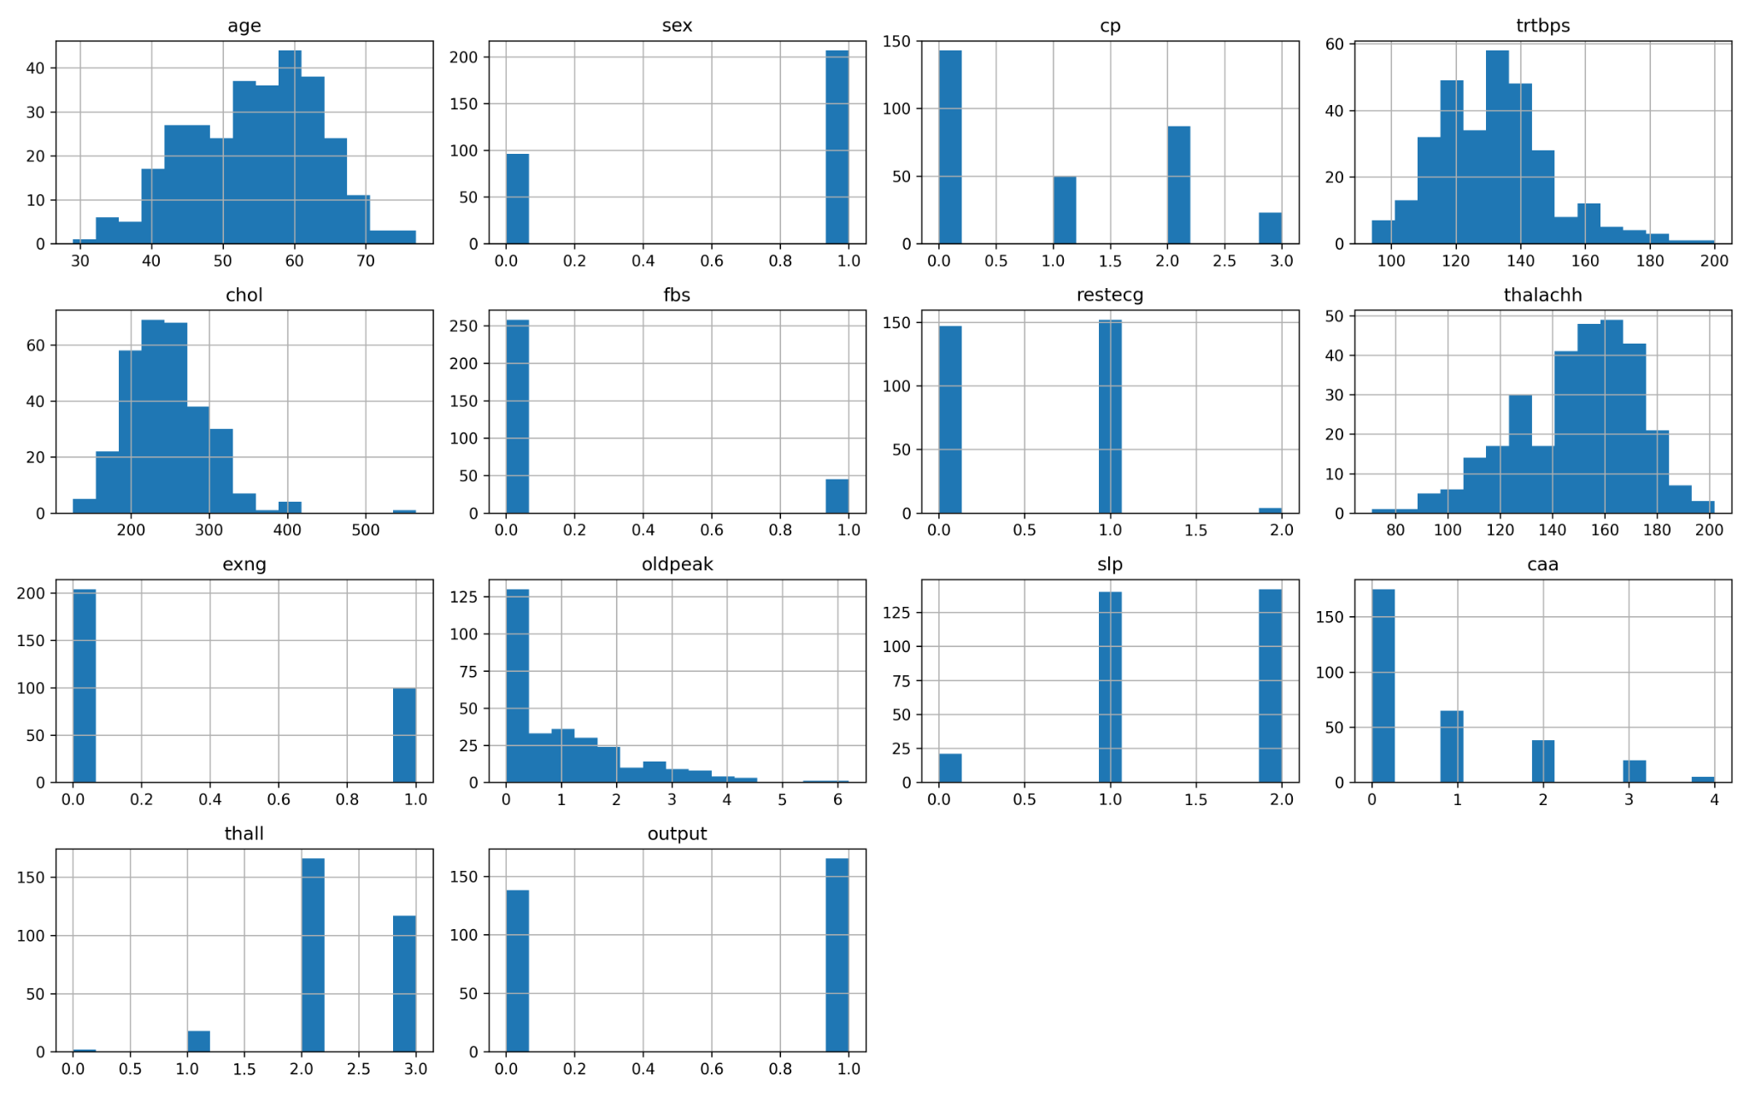
Histogram of all features

Slide 7
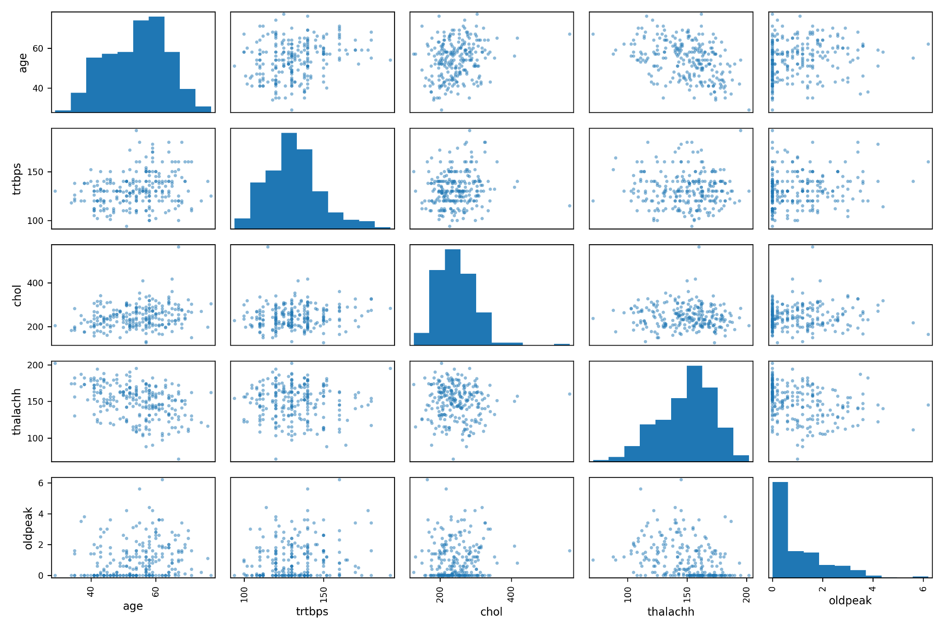
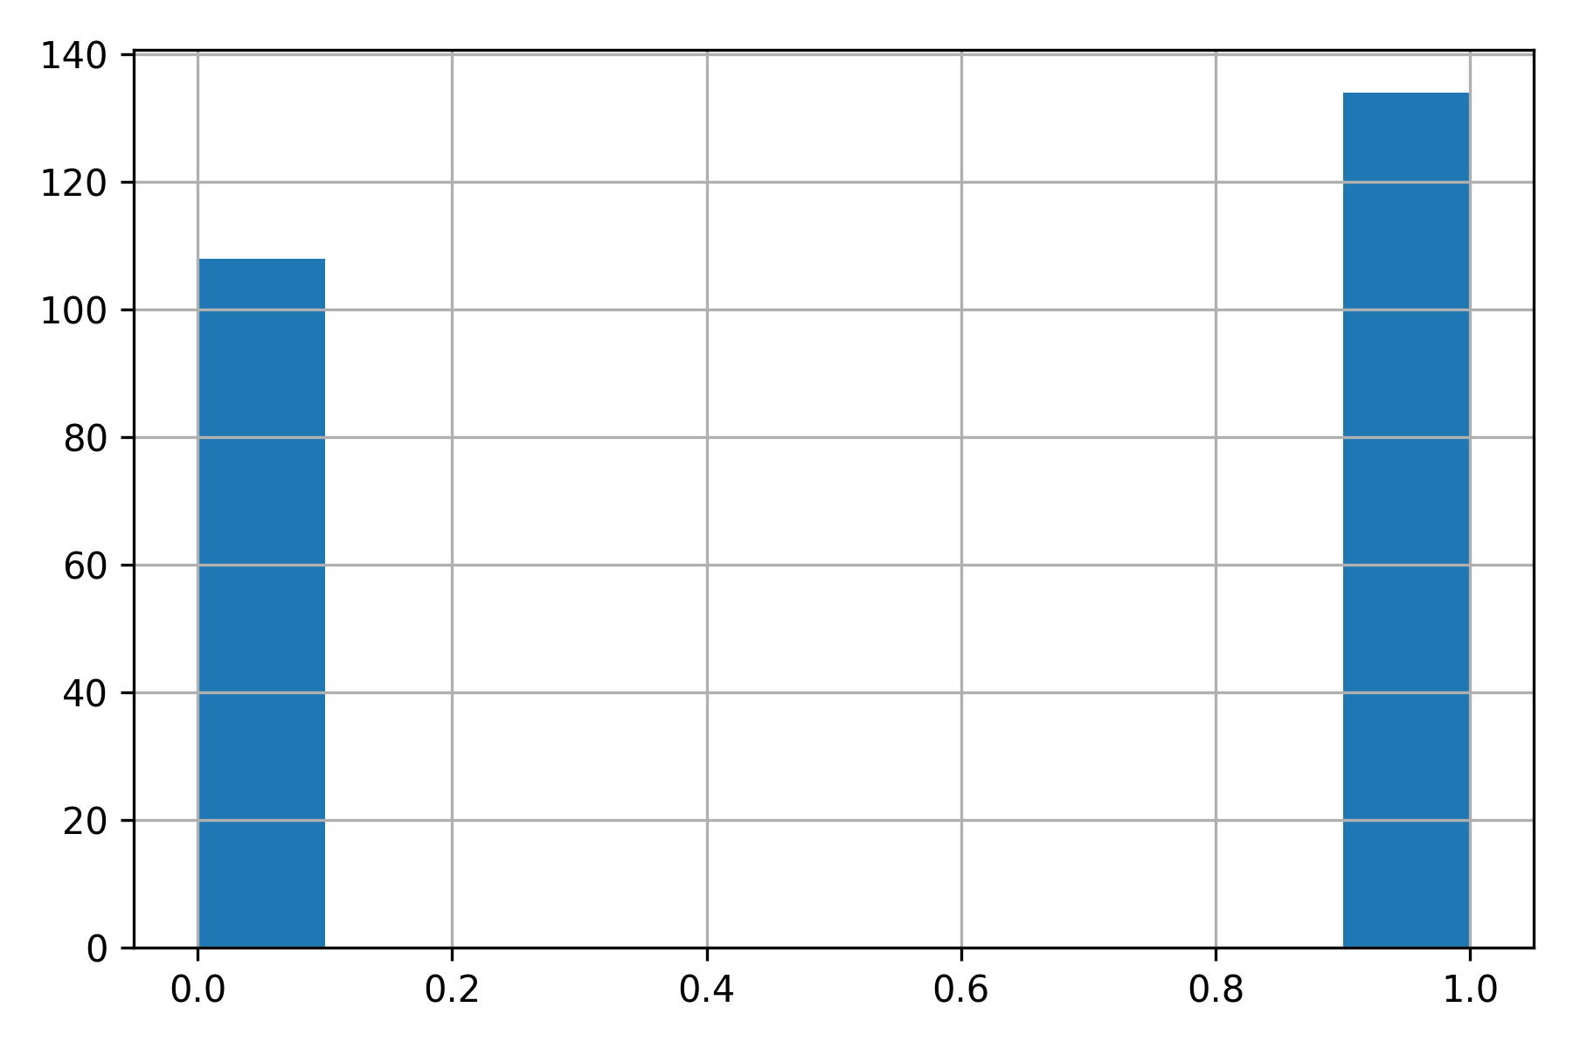
Balance Assessment
Training Set (80% of dataset)
Percentage Not Risk: 44.6%
Percentage Risk: 55.4%

Slide 8
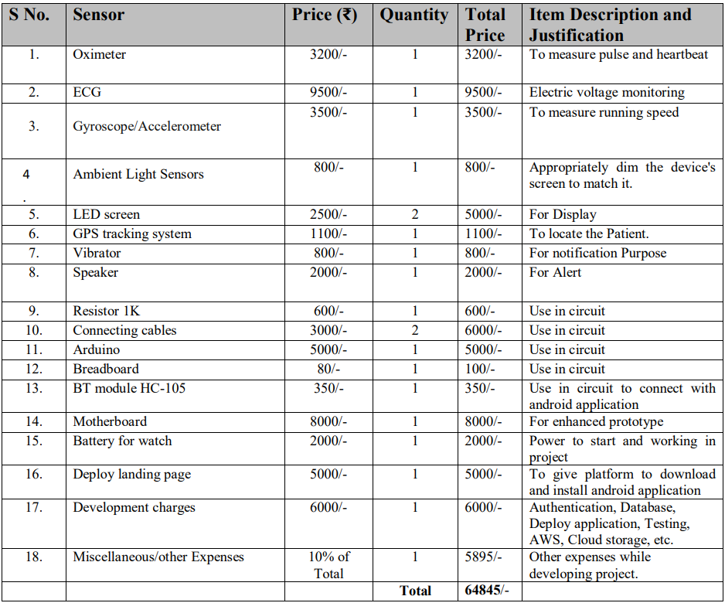
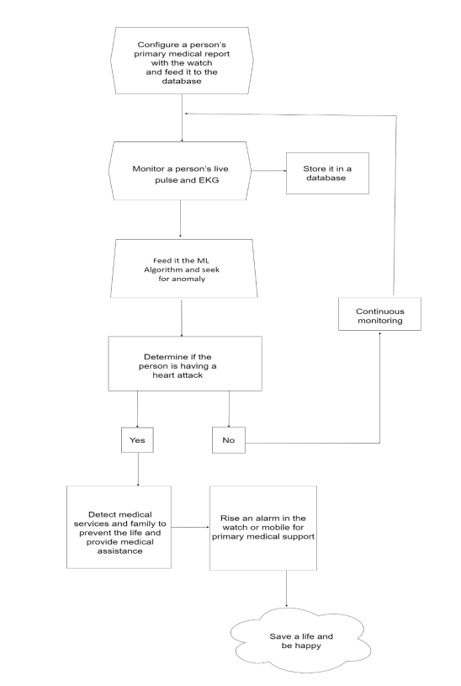
Budget

Slide 9
Summary and Future
The next phase of our Engineering Design Project will be to create a prototype of how product functions and give a basic understanding to the stakeholder of the functionality of the product. This is the phase where we finalize the design, components and conduct testing in order to convert into tangible output.

Slide 10
Thank You

